Slide 1
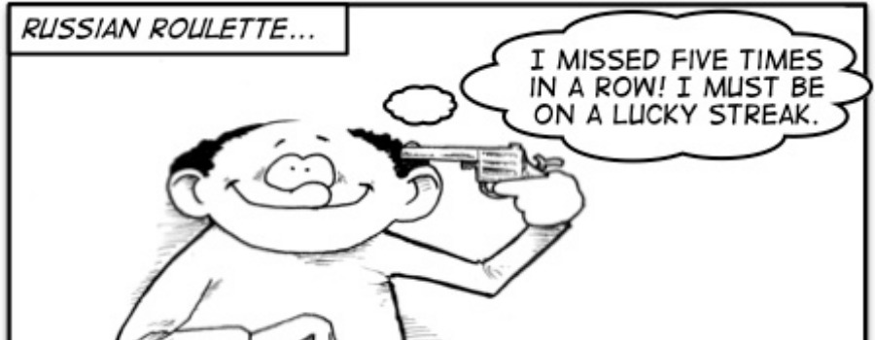
Existence of Gambler’s Fallacy and Hot Outcome on Goalkeeper’s Decision Making

Slide 2
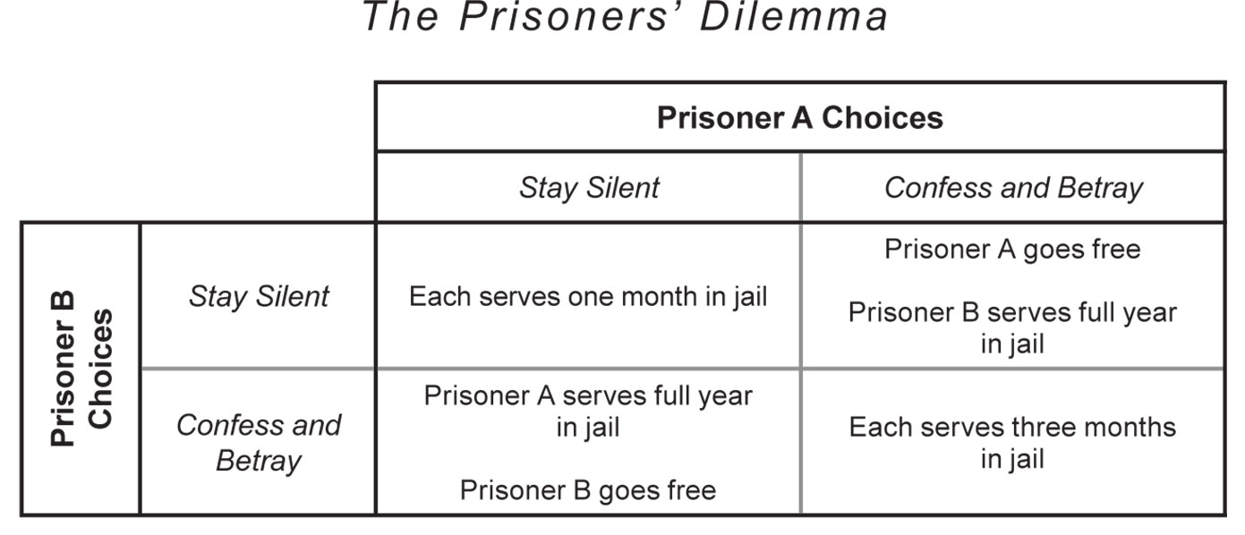
Incentive? Why this idea?
Inspired by Game Theory -> Define as decision-making where several players must make choices that potentially affect other players (Turocy & von Stenge, 2001).
e.g. Prisoner’s Dilemma
Hobbies -> Researching on sports is not boring, especially watching professional sports game. Likewise world cup, AFC and NBA.

Slide 3

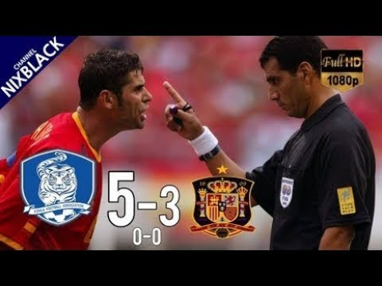
Why researching on penalty shootout?
Most intense -> One of the most intense part of the football game.
Game Decider -> Decider which team to proceed or go home.
Mentality -> Being calm is the key and it is a psychology game.
Drama -> Underdog team can beat the superior team.
e.g: Croatia beat England in penalty shootout and go to final world cup 2018
Korea win 5-3 facing Spain in World Cup 2002 penalty shootout

Slide 4
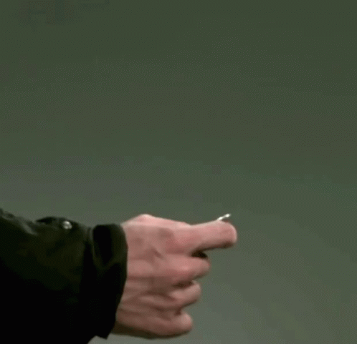
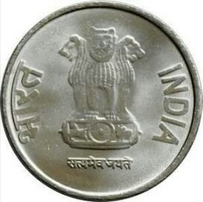
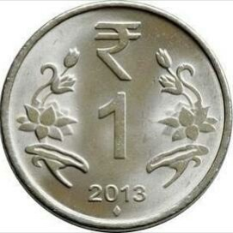
What is Gambler’s Fallacy Result?
Definition Negative autocorrelation of an i.i.d random sequence
The believers of this fallacy admit whether a streak will be more highly possible to break as the sequence streak getting longer.
For instance,

Slide 5
What is Hot Outcome Result?
Definition Positive autocorrelation of an i.i.d random sequence
Hot hand believers admit the successful outcome has greater chance in further attempt.
For example, the hot hand person will still pursue playing after winning 4 streaks of flip coin game in a row.

Slide 6
What will this research do?
Use goalkeeper perspective in penalty shootout to determine either fallacy pattern is occurred.
Why? In penalty shootout only the goalkeeper remain the same in every kicks which is important for streaks issue.
In Stock Market:
By identifying a new pattern in the stock market might gain an edge over other competitors, that means it can predict the future outcome through the pattern (Nesbitt and Barrass, 2004).

Slide 7
Aim of this Research
Check the existence of gamblers fallacy or hot outcome pattern on the real-world data.
Determine whether these patterns will be useful for the goalkeeper in the future.

Slide 8
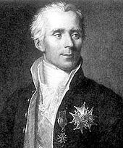
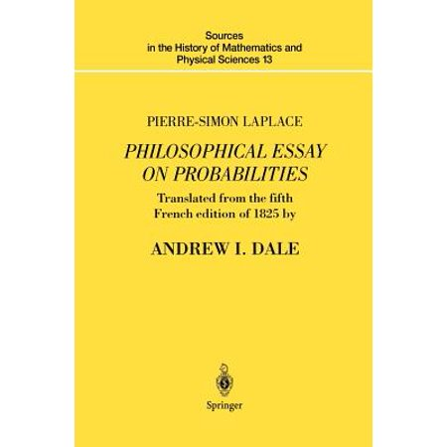
Literature Review
Gambler Fallacy
Laplace (1825), a French mathematician firstly discovered the concept of gambler fallacy through some experiment of a coin toss
Later then Laplace did expand his study with some similar area like on gambling and lottery.

Slide 9
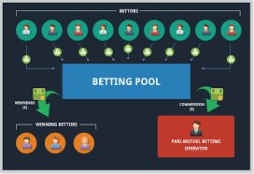
Clotfelter and Cook (1993) researched on the behavior for all 52 consecutive winning sample data on pari-mutuel lottery.
At announcement day it will be equally shared.
It showed the probability of the same number will be picked for following or next month lottery was reduced after that number win today.

Slide 10
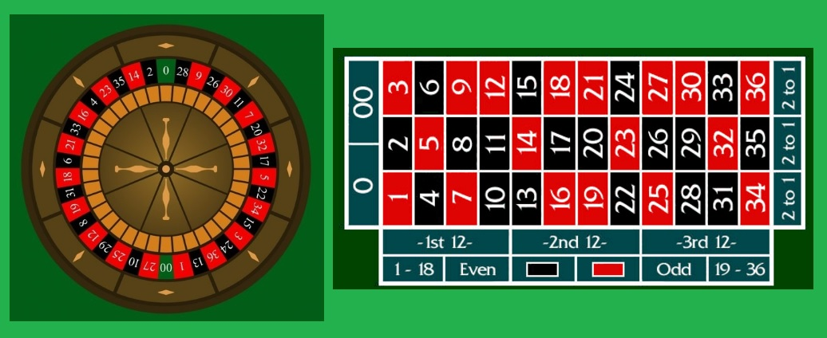
On roulette wheel, Ayton and Fischer (2004) found there is negative recency (gambler fallacy) following streak outcome of 1 to 5.
Croson and Sundali (2005) added despite the statistical illusion in gambling.
Gamblers still fell into the fallacy illusion after seeing the same outcome appears in 5 or more consecutively.

Slide 11

Hot Hand Fallacy
Tversky and Gilovich (1989) also learned the trend of hot outcomes in basketball. They believed each successful shoot might increase player momentum, confidence and morality boost. (On Fire)
Sundali and Croson (2005) studied similar evidence on hot outcome regarding gambling, they analyzed 18 hours of roulette wheel data.
The data showed consistency on bettors’ performance where they tend to play more when winning the game since they assume it is their ‘lucky day’.

Slide 12

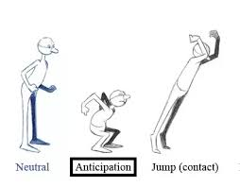
Psychology???
In penalty shootout, goalkeeper’s decision making is crucial for winning the game (Welsh, 1980).
Goalkeeper’s anticipation which also part of behavior is important
(Hunter, Murphy, Angilletta Jr. and Wilson, 2018).
Goalkeepers tend to action rather than stay in the middle (Kahneman and Miller, 1986). Fans and observers will psychologically perceive a worse habit of the goalkeeper when they just stay in the middle.

Slide 13
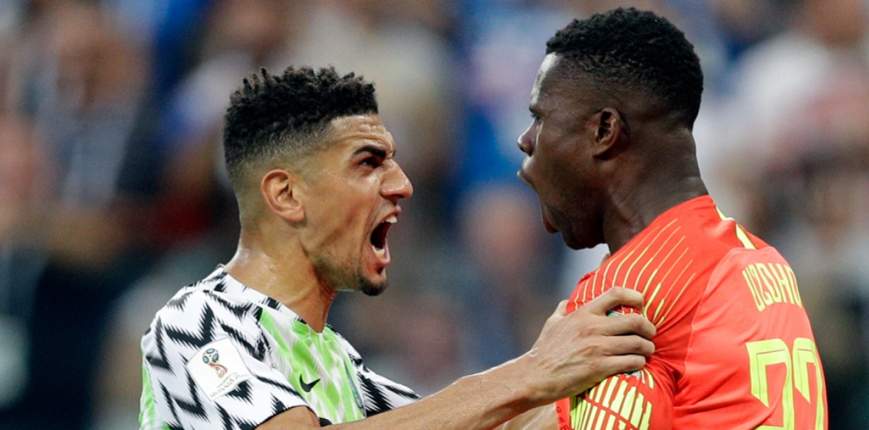
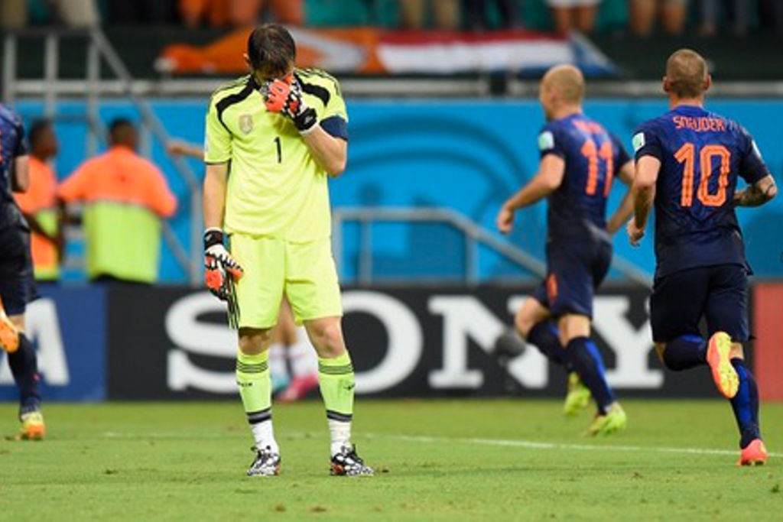
Apesteguia and Palacios-Huerta (2010) observed kicking order can affect the player and team psychology.
How so?
Random psychological pressure may be generated between shoots.
Each shoot or save may give either:
Morale Boost
Mental Breakdown

Slide 14


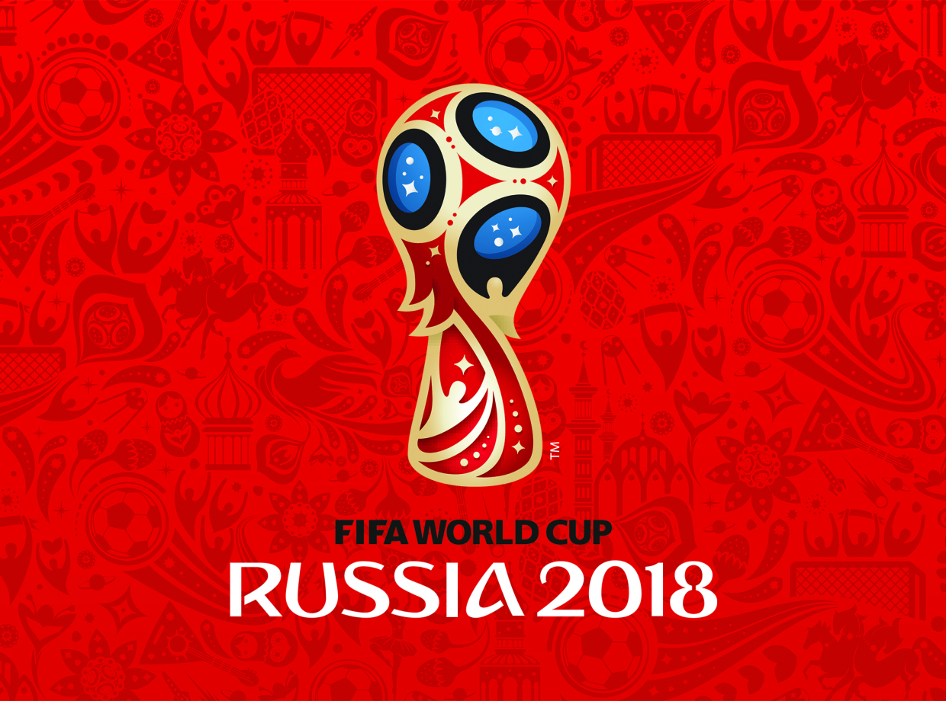
Methodology
The data will consist of penalty shootouts from World Cup, UEFA Europa League and AFC Asian Cup from the last 20 years (1998 – 2018).
Tournaments | Number of Penalty | Weights
UEFA Europa League | 40 | 60%
World Cup | 19 | 28%
AFC Asian Cup | 8 | 12%
Total | 67 | 100%
Recourses:
- theadgalternative.com
- YouTube
- Goal.com
From the result there are a total of 67 penalty shootouts.

Slide 15
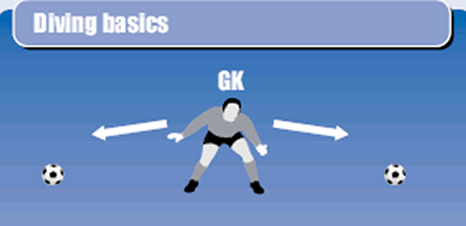
To keep the same frequency of total kicks, some limit is needed here.
Penalty shootouts that is more than 10 kicks in total will be eliminated.
Reason? To avoid more error and some unwanted outcome.
If goalkeeper freeze in the middle, the data will simply be omitted.
Another reason is due to not much data of goalkeeper stays in the middle.
Support In literature review goalkeeper’s favour more to action instead of inaction
LEFT MIDDLE RIGHT

Slide 16
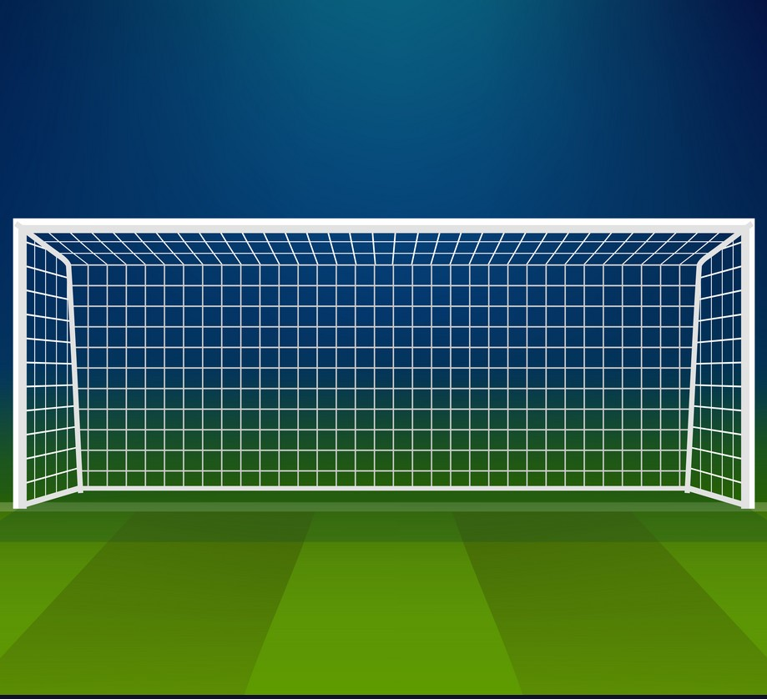
How to determine the direction?
4
Red Line -> Left & Right Boundaries
Ball 1 : Lower left Goal (Left)
Ball 2 : Hit the bar (Left)
Ball 3 : Top Right Goal (Right)
Ball 4 : Missed (Right)
2
3
1
LEFT RIGHT

Slide 17
How is the Analysis?
Since we check according to the goalkeeper’s perspective, goalkeepers guess need to be examined.
Streaks of 1, 2, 3 and 4
Correct and Incorrect Prediction
Same and Opposite Direction
At most of 5 kicks for each goalkeeper, so 4 streaks are reasonable
Prediction Results will be separated for correct and incorrect streaks.
To check Gambler’s Fallacy and Hot Outcome results
Streak length | Previous kick | Previous dive | Prediction Result | Next Kick Prediction
 |  |  |  | Gambler Fallacy | Hot Outcome
2 | Left (2 in a row) | Left (2 in a row) | Correct | Right | Left
 | Right (2 in a row) | Right (2 in a row) | Correct | Left | Right
 | Left (2 in a row) | Right (2 in a row) | Incorrect | Right | Left
 | Right (2 in a row) | Left (2 in a row) | Incorrect | Left | Right
Example of 2 consecutive correct/incorrect prediction

Slide 18
For More Details
CROATIA vs RUSSIA in 2018 World Cup
Croatia Goalkeeper | Russia Goalkeeper
Goalkeeper-> Left , Kicker -> Left (not Goal) | Goalkeeper-> Right , Kicker -> Right (Goal)
Goalkeeper-> Left , Kicker -> Right (Goal) 1 Streak of same direction & correct prediction | Goalkeeper-> Right , Kicker -> Right (not Goal)
Goalkeeper-> Left , Kicker -> Left (not Goal) 1 Streak of same direction & incorrect prediction | Goalkeeper-> Left , Kicker -> Left (Goal) 2 Streaks of opposite direction & correct prediction
Goalkeeper-> Right , Kicker -> Left (Goal) 1 Streak of opposite direction & correct prediction | Goalkeeper-> Right , Kicker -> Left (Goal) 1 Streak of opposite direction & correct prediction
Goalkeeper-> Right , Kicker -> Left (Goal) | Goalkeeper-> Right , Kicker -> Left (Goal)

Slide 19
First Objective
Use Binomial Distribution as left and right are equally distributed with probability 0.5 each and independently distributed between kicks.
One-tailed and Two-tailed test will be needed to test the goalkeeper dive behaviour (same or opposite way) after different streaks.
This method might determine whether there is gambler fallacy or hot outcome exist on the data (Croson & Sundali, 2005). This might answer our first objective.

Slide 20
Hypothesis Testing:
One-tailed(1): H₀: p <= 0.5 & H₁: p > 0.5 for Gambler’s Fallacy > Hot Outcome
One-tailed(2): H₀: p >= 0.5 & H₁: p < 0.5 for Gambler’s Fallacy < Hot Outcome
Two-tailed: H₀: p = 0.5 & H₁: p ≠ 0.5
p is probability of goalkeeper dive to opposite direction.
5% of significance level (α)

Slide 21
Second Objective
Checking whether the fallacy is not a mere fallacy, need to show correct prediction of Gambler’s fallacy and Hot outcome is significantly distributed.
Due to small data, Fisher’s exact test might work better instead of chi-square and F-distribution test (Sarkar, 2017). Use 5% significance level.

Slide 22
Croatia Goalkeeper | Russia Goalkeeper
Goalkeeper-> Left , Kicker -> Left (not Goal) | Goalkeeper-> Right , Kicker -> Right (Goal)
Goalkeeper-> Left , Kicker -> Right (Goal) | Goalkeeper-> Right , Kicker -> Right (not Goal)
Goalkeeper-> Left , Kicker -> Left (not Goal) 1 Streak of same incorrect prediction but correct after | Goalkeeper-> Left , Kicker -> Left (Goal) 2 Streaks of same correct prediction and correct after
Goalkeeper-> Right , Kicker -> Left (Goal) | Goalkeeper-> Right , Kicker -> Left (Goal)
Goalkeeper-> Right , Kicker -> Left (Goal) | Goalkeeper-> Right , Kicker -> Left (Goal)

Slide 23
Hypothesis Testing:
H₀: x₁ is independent to x₂
H₁: x₁ is dependent to x₂
x₁ is the probability of Gambler’s fallacy
x₂ is the probability of Hot outcome.
5% of significance level (α)

Slide 24
Analysis Results
STREAKS OF CORRECT PREDICTION
Frequency of Goalkeepers dive to opposite or same direction in the next kick after several sequence streak length of correct prediction (1,2 and 3 streaks)
Sequence Length | Opposite Direction (Gambler’s Fallacy) | Same Direction (Hot Outcome) | Total
1 | 138 (61%) | 88 (39%) | 226
2 | 24 (72.7%) | 10 (27.3%) | 33
3 | 3 (100%) | 0 (0%) | 3

Slide 25
Bar graph favours on the pattern of Gambler’s fallacy instead of Hot outcome
Binomial Test
One-tailed: H₀: p <= 0.5 & H₁: p > 0.5
Two-tailed: H₀: p = 0.5 & H₁: p ≠ 0.5
p is probability of goalkeeper dive to opposite direction.
Sequence Length | One-tailed p-value | Two-tailed p-value
1 streak (226 data) | 0.0005355 (Reject H₀) | 0.001071 (Reject H₀)
2 streaks (33 data) | 0.006765 (Reject H₀) | 0.01353 (Reject H₀)
3 streaks (3 data) | 0.25 (not reject H₀) | 0.125 (not reject H₀)
H₁: p > 0.5,
H₁: p ≠ 0.5
H₁: p > 0.5,
H₁: p ≠ 0.5
*5% of significance level (α)
*Omit 3 streaks (small data)

Slide 26
STREAKS OF INCORRECT PREDICTION
Frequency of Goalkeepers dive to opposite or same direction in the next kick after several sequence streak length of incorrect prediction (1,2 and 3 streaks)
Sequence Length | Opposite Direction (Hot Outcome) | Same Direction (Gambler’s Fallacy) | Total
1 | 80 (48%) | 87 (52%) | 167
2 | 19 (52.8%) | 17 (47.2%) | 36
3 | 2 (67%) | 1 (33%) | 3

Slide 27
Bar graph favours on the pattern of Hot outcome instead of Gambler’s fallacy
Binomial Test
One-tailed: H₀: p >= 0.5 & H₁: p < 0.5 (for 1 streak)
One-tailed: H₀: p <= 0.5 & H₁: p > 0.5 (for 2,3 streaks)
Two-tailed: H₀: p = 0.5 & H₁: p ≠ 0.5
p is probability of goalkeeper dive to opposite direction.
Sequence Length | One-tailed p-value | Two-tailed p-value
1 streak (167 data) | 0.3169 (not reject H₀) | 0.6338 (not reject H₀)
2 streaks (36 data) | 0.434 (not reject H₀) | 0.8679 (not reject H₀)
3 streaks (3 data) | 1 (not reject H₀) | 0.5 (not reject H₀)
H₀: p >= 0.5,
H₀: p = 0.5
H₀: p <= 0.5,
H₀: p = 0.5
*5% of significance level (α)
*Omit 3 streaks (small data)

Slide 28
Fallacy Biases
Proportion of Goalkeepers dive correctly predicted in the next kick after several sequence streak length of correct prediction (1,2 and 3 streaks)
The 3 streaks is omitted due to small sampling we obtained from the previous results
Sequence Length | Opposite Direction (Gambler’s Fallacy) | Same Direction (Hot Outcome)
1 | 82 out of 138 (59%) | 49 out of 88 (56%)
2 | 13 out of 24 (57%) | 4 out of 10 (40%)

Slide 29
Examine whether Gambler’s fallacy is independent to Hot outcome or vice versa
Fisher’s Exact Test
H₀: x₁ and x₂ are independent
H₁: x₁ and x₂ are dependent
x₁ is the probability of Gambler’s fallacy.
x₂ is the probability of Hot outcome.
*5% of significance level (α)
Subsequent Kicks following | p-value
1 Correct | 0.8751 (not reject H₀)
2 Correct | 0.7486 (not reject H₀)
The test indicates whether both Gambler’s fallacy and Hot outcome are independent to each other. (Can be seen from both fallacies are reduced as streaks increase).

Slide 30
Proportion of Goalkeepers dive correctly predicted in the next kick after several sequence streak length of incorrect prediction (1,2 and 3 streaks)
The 3 streaks is omitted due to small sampling we obtained from the previous results
Sequence Length | Opposite Direction (Hot Outcome) | Same Direction (Gambler’s Fallacy)
1 | 46 out of 80 (58%) | 42 out of 87 (48%)
2 | 10 out of 19 (52%) | 10 out of 17 (59%)

Slide 31
Examine whether Gambler’s fallacy is independent to Hot outcome or vice versa
Fisher’s Exact Test
H₀: x₁ and x₂ are independent
H₁: x₁ and x₂ are dependent
x₁ is the probability of Gambler’s fallacy.
x₂ is the probability of Hot outcome.
*5% of significance level (α)
Subsequent Kicks following | p-value
1 Correct | 0.5838 (not reject H₀)
2 Correct | 0.4569 (not reject H₀)
No guarantee one fallacy is better than other due to independency. Psychological effect might occur because the test did not show significant results to the empirical evidence.

Slide 32
Discussion
For a goalkeeper who dove based on correct prediction for any length of streaks (1,2 and 3), both empirical and testing results show Gambler’s Fallacy > Hot Outcome
Another previous study regarded to penalty shootout also stated whether the outcome (by considering previous successive kicks) is positively into Gambler’s fallacy as well (Misirlisoy & Haggard, 2014).
For a goalkeeper who dove based on incorrect prediction for any length of streaks (1,2 and 3), Empirical evidence -> Hot outcome
Hypothesis testing -> not significant to any fallacies
Ayton and Fischer (2004), they believed goalkeepers decision on choosing for Gambler’s fallacy are naturally based on behaviour and feeling.
Therefore by considering psychology and another factor, some bias might have occurred.

Slide 33
Testing the Fisher’s Exact test to check if the fallacy is just a mere fallacy or not. We obtained:
1. For previous Correct decision made, the Empirical evidence showed Gambler’s
fallacy and Hot outcome are falling off corresponding to the higher length of
streaks, Gambler’s Fallacy > Hot outcome.
From p-value, the results show statistically significant independent between both fallacies. (Both decreasing)
2. For previous Incorrect decision made, the Empirical evidence showed
Gambler’s Fallacy > Hot outcome. P-value also showed no independency.
Both outcomes explain there is no correlation between increasing streaks based on fallacy with better prediction. These fallacies are just a mere illusion

Slide 34
Conclusion
In real world, Goalkeepers tend to dive based on Gambler’s fallacy for previous correct prediction. (Proven)
No preference pattern on goalkeeper dives for streak of an incorrect prediction.
No statistically significant evidence for one pattern is better than another. (Using Fisher’s Exact test for previous correct and incorrect).
Some Psychology or another effect might occur to the biasness. Therefore, further psychology research on penalty shootout need to be examined.

Slide 35
REFERENCE
Turocy, T. & von Stengel, B., 2001. Game Theory. London: Academic Press, London School of Economics.
Laplace, P.S. (1825) Philosophical Essay on Probabilities, New York, Springer-Verlag, Available from:https://books.google.co.kr/books?id=vDZzuGcM4DUC&pg=PA91&dq=Illusions+in+the+Estimation+of+Probabilities,%E2%80%9D&hl=en&sa=X&ved=0ahUKEwjhrvvoiO_eAhUKXLwKHUdFDkMQ6AEIKDAA#v=onepage&q=independent&f=false (Accessed: 25 November 2018)
History of Football - The Origins (2018) [Online] FIFA. Available at: https://www.fifa.com/about-fifa/who-we-are/the-game/index.html (Accessed: 2 November 2018)
Clotfelter, C.T. & Cook, P.J. (1993) ‘The Gambler’s Fallacy in Lottery Play’, National Bureau of Economic Research [Online]. Available at: https://www.researchgate.net/publication/5191744_The_Gambler's_Fallacy_in_Lottery_Play (Accessed: 25 November 2018)
Croson, R. & Sundali, J. (2005) ‘The Gambler’s Fallacy and the Hot Hand: Empirical Data from Casinos’, The Journal of Risk and Uncertainty, 30(3), pp. 195-209. (Accessed: 9 November 2018)
Terrell, D. & Farmer, A. (1996) ‘Optimal Betting and Efficiency in Parimutuel Betting Markets with Information Costs’, The Economic Journal, 106(437), pp.846-868. (Accessed: 25 November 2018)
Xu, J. & Harvey, N. (2014) ‘Carry on Winning: The Gamblers’ Fallacy Creates Hot Hand Effects in Online Gambling’, Cognition, 131(2), pp. 173-180. (Accessed: 25 November 2018)

Slide 36
Ayton, P. & Fischer, I. (2004) ‘The hot hand fallacy and the gambler’s fallacy: Two faces of subjective randomness?’, Memory & Cognition, 32(8), pp. 1369-1378. (Accessed: 25 November 2018)
Tversky, A. and Gilovich, T. (1989) ‘The Cold Facts About the Hot Hand in Basketball’, Chance, 2(1), pp. 16-21. (Accessed: 26 November 2018)
Hunter, A.H., Murphy, S.C., Angilletta Jr, M.J. & Wilson, R.S. (2018) ‘Anticipating the Direction of Soccer Penalty Shots Depends on the Speed and Technique of the Kick’, MDPI [Online]. Available at: https://www.mdpi.com/2075-4663/6/3/73/pdf (Accessed: 22 November 2018)
Kahneman and Miller (1986) ‘Norm Theory: Comparing Reality to Its Alternatives’, Psychological Review, 93(2), pp. 136-153. (Accessed: 22 November 2017)
Welsh, A. (1990) The Soccer Goalkeeping Handbook, London, Bloomsbury Publishing Plc, Available from: https://books.google.co.kr/books?hl=en&lr=&id=ukOkAgAAQBAJ&oi=fnd&pg=PA6&dq=welsh+goalkeeping&ots=1YBa6QA4bi&sig=qVfgfeXISIykw82ztOU33BXFLUo#v=onepage&q=welsh%20goalkeeping&f=false (Accessed: 22 November 2018)
Apesteguia, J. and Palacios-Huerta, I. (2010) ‘Psychological Pressure in Competitive Environments: Evidence from a Randomized Natural Experiment’, American Economic Review, 100(5), pp. 2548-2564. (Accessed: 23 November 2018)
Sarkar, A. (2017) ‘The Gamblers Fallacy and Hot Outcome: Cognitive Biases or Adaptive Thinking for Goalkeepers Decisions on Dive Direction During Penalty Shootouts’, Bowling Green State University [Online]. Available at: https://etd.ohiolink.edu/!etd.send_file?accession=bgsu1483529030818181&disposition=inline (Accessed: 26 November 2018)

